Slide 1

18ECC303J – Computer Communication Networks
Course Credit : 4
Theory : 9 Hours
1. Behrouz A. Fehrouzan, “Data communication & Networking”, Mc-Graw Hill, 5th Edition Reprint, 2014.
2. Andrew S. Tanenbaum, “Computer Networks”, Pearson Education India, 5th Edition, 2013.
3. William Stallings, “Data & Computer Communication”, Pearson Education India, 10th Edition, 2014.

Slide 2
Unit-2 : OSI Lower Layers
OSI Network models
Layered Architecture
Data Link Layer - Introduction
Link Layer Addressing
Error detection and Correction
Data Link control – LLC
Data Link control – MAC
Flow and Error Control Protocol
ARQ Schemes
HDLC protocol

Slide 3
Unit 2 –Week 6
High level Data Link Control (HDLC) Protocol

Slide 4
HDLC
High-level Data Link Control (HDLC)
It is published by ISO.
It is a bit-oriented protocol. It implements ARQ mechanisms
HDLC supports both half duplex and full duplex modes in point to point and multipoint configurations

Slide 5
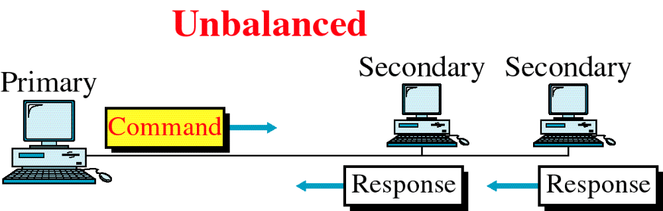
HDLC Configuration
In this one device is primary and other is secondary
If it is point to point only two devices are involved
If it is multipoint one primary controlling several secondary's.
WCB/McGraw-Hill
© The McGraw-Hill Companies, Inc., 1998

Slide 6
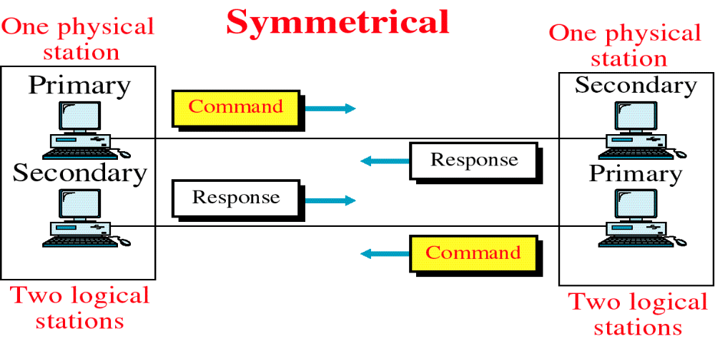
HDLC Configuration
Each physical station on a link consists of two logical stations
One primary and the other a secondary
Separate lines link the Primary of one physical station to secondary aspect of another physical station.

Slide 7

HDLC Configuration
In balanced types both the point to point topology are of combined type.
Stations are link by a single line
That is controlled by either station

Slide 8
HDLC MODES
HDLC supports three modes of communication between station
Normal Response Mode (NRM)
Asynchronous Response Mode (ARM)
Asynchronous Balanced Mode (ABM)
WCB/McGraw-Hill
© The McGraw-Hill Companies, Inc., 1998

Slide 9
HDLC MODES
Normal Response Mode (NRM)
Refers to standard Primary – Secondary relationship
In this mode, secondary device must have permission from the primary device before transmitting
Once permission has been granted, the secondary may initiate a response transmission of one or more frames containing data.
Asynchronous Response Mode (ARM)
Refers to standard Primary – Secondary relationship
In this mode, secondary device may initiate transmission without permission from the primary whenever the channel is idle.
All transmissions from a secondary must be made to the primary for relay to a final destination
Asynchronous Balanced Mode (ABM)
In this mode, all stations are equal
Only combined stations connected in point to point are used.
Either combined station may initiate transmission with the other combined station without permission.

Slide 10
HDLC Frame Types
HDLC defines three types of frames:
  Information frames (I-frames)
  Supervisory frames (S-frames)
  Unnumbered frames (U-frames)
  Each type of frame works as an envelope for the transmission of a different types of message
I-frames are used to transport user data and control information relating to user data
S-frames are used only to transport control information.
U-frames are reserved for system management.
Information carried by U-frames is intended for managing the link itself.

Slide 11
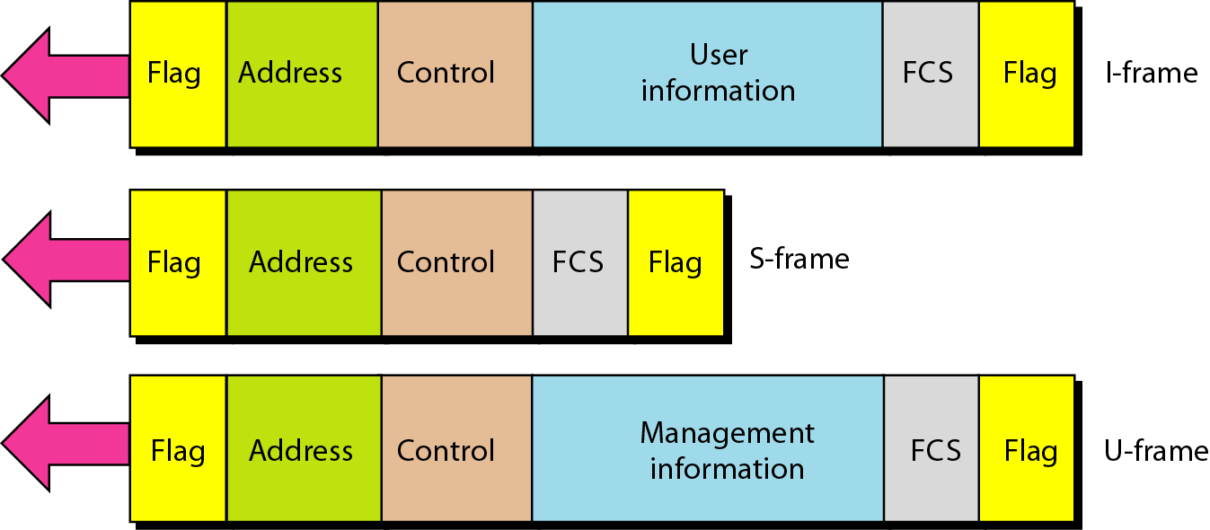
Figure 11.27 HDLC frames
11.<number>

Slide 12
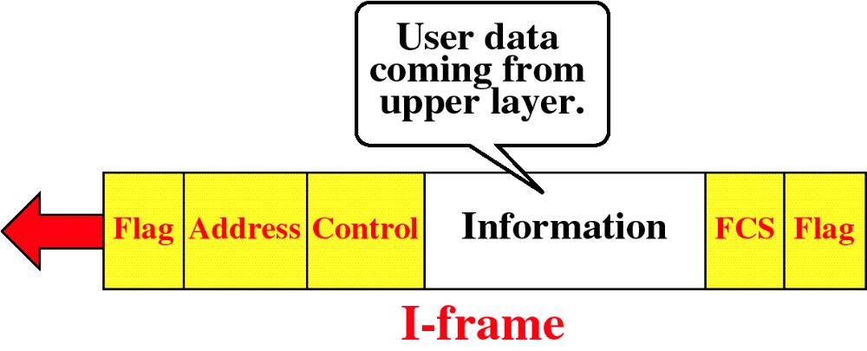
HDLC Frame Types
WCB/McGraw-Hill
© The McGraw-Hill Companies, Inc., 1998

Slide 13
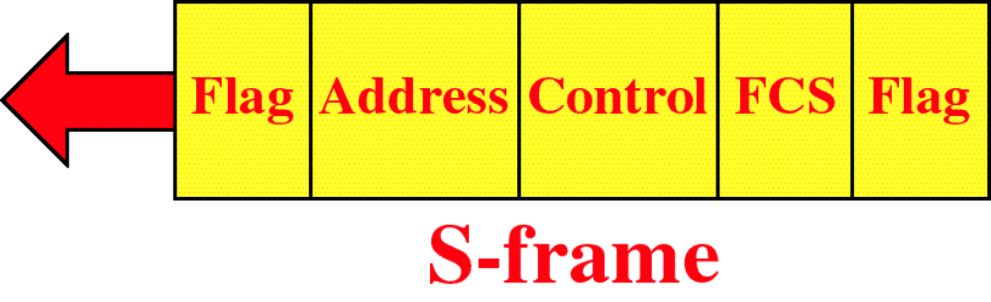
HDLC Frame Types
WCB/McGraw-Hill
© The McGraw-Hill Companies, Inc., 1998

Slide 14
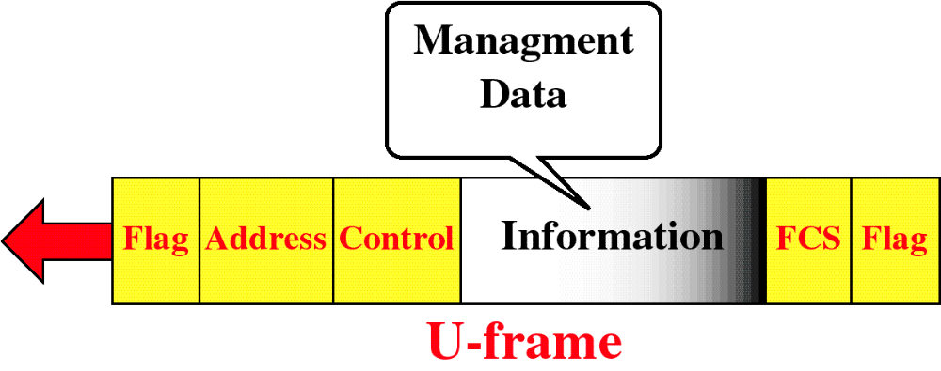
HDLC Frame Types
WCB/McGraw-Hill
© The McGraw-Hill Companies, Inc., 1998

Slide 15
HDLC Frame Fields
Each frame in HDLC contains the following six fields
  Beginning flag field
  Address field
  Control field
  Information field
  Frame check sequence (FCS) field
  Ending Flag field

Slide 16
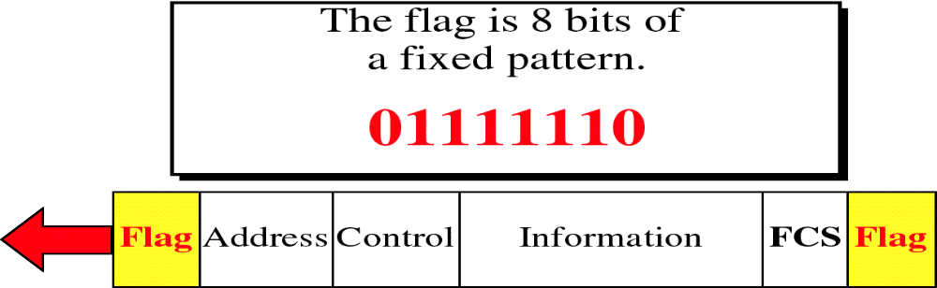
HDLC Flag Field
Flag
It is an 8-bit sequence with the bit pattern 01111110 that identifies the beginning and end of a frame.
It serves as a synchronization pattern for the receiver.
WCB/McGraw-Hill
© The McGraw-Hill Companies, Inc., 1998

Slide 17
Bit Stuffing and removal
HDLC uses a process called bit stuffing
Sender wants to transmit a bit sequence having more than five consecutive 1s. It inserts one redundant 0 after the fifth 1
For example 011111111000 becomes 0111110111000
It indicates the receiver that the current sequence is not a flag, its data
Once the receiver has seen the stuffed 0, it is dropped from the data and the original bit stream is restored.
Bit stuffing is the process of adding one extra 0 whenever there are five consecutive 1s in the data
So that receiver does not mistake the data for a flag.

Slide 18
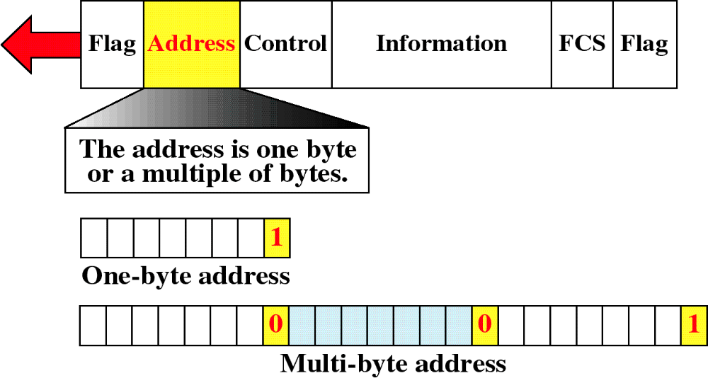
HDLC Address Field
    It contains address of the secondary station.
    If a primary station created the frame, it contains a to address.
    If a secondary creates the frame, it contains a from address.
    An address field can be 1 byte or several bytes, depending on the network.
    If the address is only one byte, the last bit is always 1.
    If the address is more than one byte, all bytes but last one will end with 0; and only the last will end with 1.

Slide 19
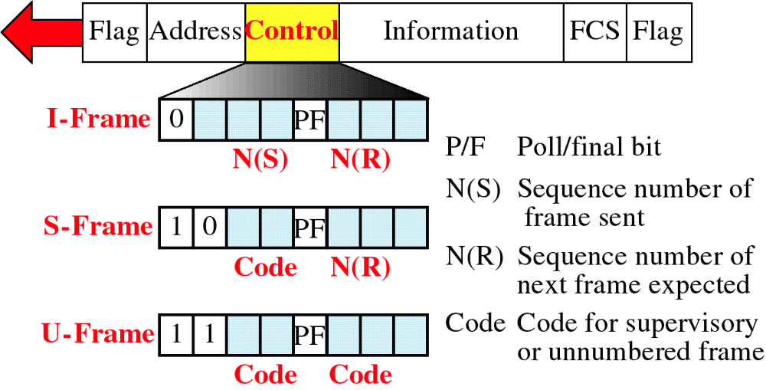
HDLC Control Field
WCB/McGraw-Hill
© The McGraw-Hill Companies, Inc., 1998

Slide 20
HDLC Control Field
Control field is a one or two byte segment of the frame
It is used for flow management
It differs depending on frame type
If the first bit is 0 – the frame is an I Frame
If the first bit is 1 and second bit is 0 – the frame is an S- Frame
If the both first and second bits are 1s – the frame is a U frame.
All three types of frames contain a bit called the Poll/Final (P/F) bit

Slide 21
Control Field of I-frame
An I frame contains two 3 bit - flow [N(S)] and error control sequence [N(R )], either side of P/F bit
N(S) – Number of frame being sent
N(R ) – Number of frame expected in return in a two way exchange
N(R ) – is the acknowledgement field
If the last frame is was error free – N(R ) number will be that of the next frame in the sequence
If the last frame was not received correctly
N(R ) number will be number of the damaged frame indicating the need for its retransmission

Slide 22
Control Field of S-Frame
Control field of S Frame contains an N(R ) field but not N(S) field
S- Frames are used to return N(R ) when the receiver does not have data of its own to send
ACK is contained in the control field of an I – Frame
S- Frame - do not transmit data and so do not require N(S) field
Two bits proceeding the P/F bit - are used to carry coded flow and error control information
Control Field of U-Frame
U – Frames have neither N(S) or N(R )
It is not designed for user data exchange of ACL
It has two code field – one two bits and other three bits either side of P/F bit
These codes are used to identify the type of U frame and its functions

Slide 23
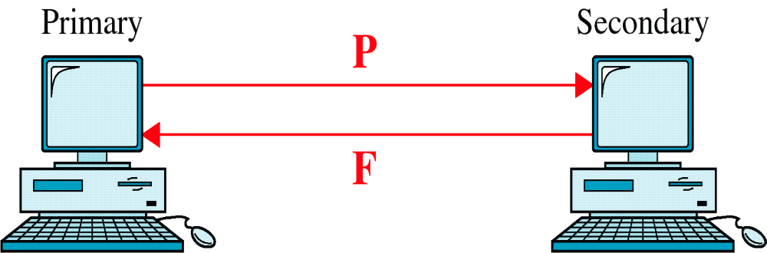
Poll / Final
P/F field is a single bit with a dual purpose
When it is set (bit = 1) mean Poll or Final
Poll → means when the frame is sent by a primary station to secondary
The address field contains the address of the receiver
Final → means when the frame is send by a secondary to a primary
When the address field contains the address of the sender

Slide 24
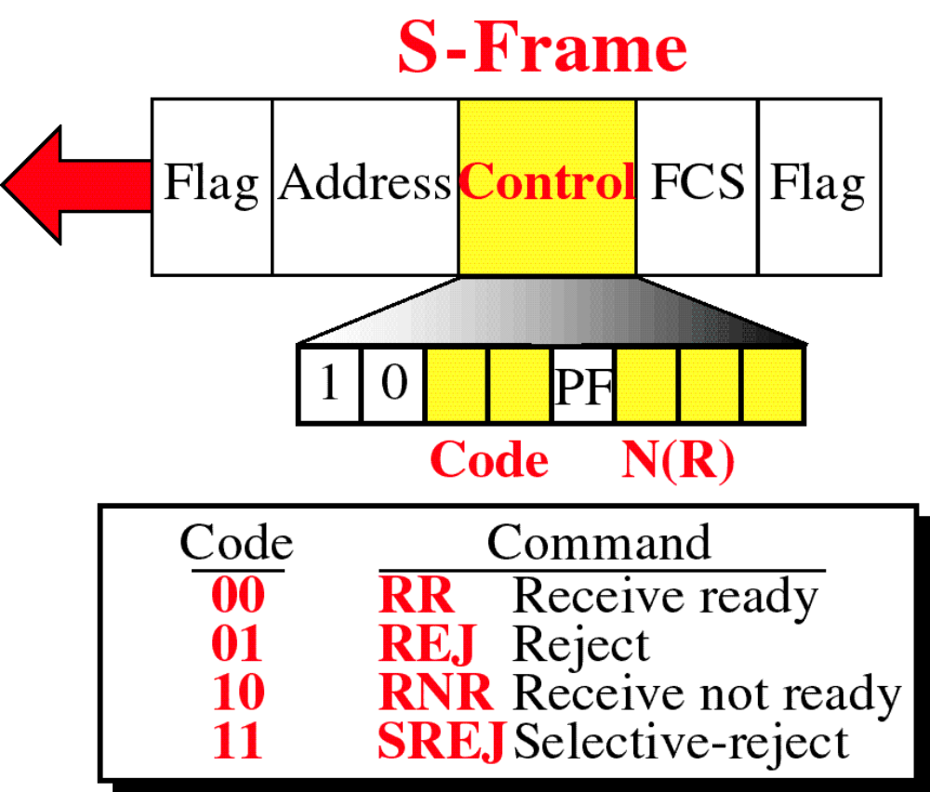
WCB/McGraw-Hill
© The McGraw-Hill Companies, Inc., 1998

Slide 25
Types of S – Frames
Receive ready (RR) : If the value of code is 00, it is an RR S-frame. This kind of frame acknowledges the receipt of a safe frame or group of frames.
Receive not ready (RNR): If the value of code is 10, it is an RNR S-frame. It acknowledges the receipt of a frame(s), and announces that the receiver is busy and cannot receive more frames. It acts as a congestion control mechanism.
Reject (REJ): If the value of the code subfield is 01, it is a REJ S-frame. This is a NAK frame used in Go-Back-N ARQ to inform the sender, before the sender time expires, that the last frame is lost or damaged.
Selective reject / repeat (SREJ): If the value of the code subfield is 11, it is an SREJ S-frame. This is a NAK frame used in Selective Repeat ARQ.

Slide 26
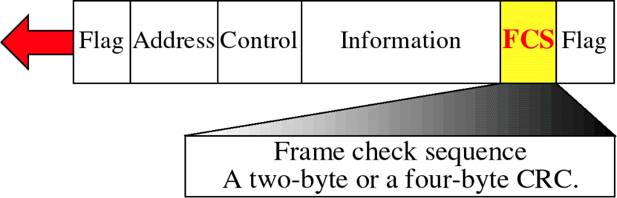
HDLC FCS Field
It is HDLC’s Error detection field
WCB/McGraw-Hill
© The McGraw-Hill Companies, Inc., 1998

Slide 27
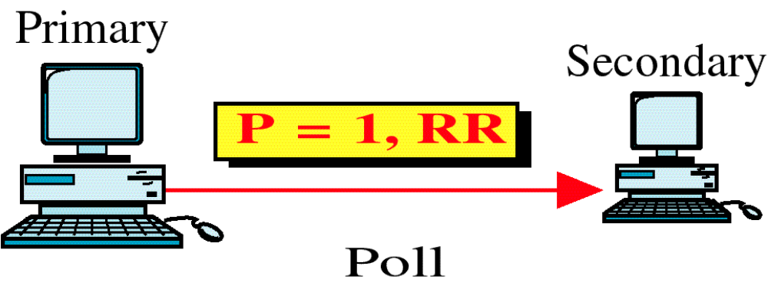
Use of P/F Field
WCB/McGraw-Hill
© The McGraw-Hill Companies, Inc., 1998

Slide 28
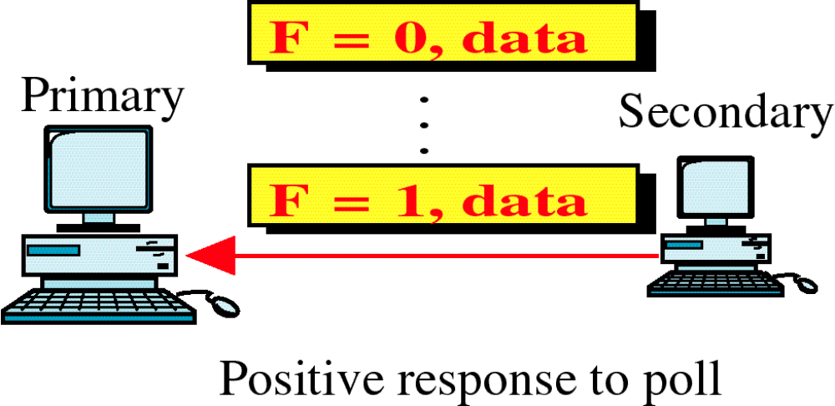
Use of P/F Field
WCB/McGraw-Hill
© The McGraw-Hill Companies, Inc., 1998

Slide 29

Use of P/F Field
WCB/McGraw-Hill
© The McGraw-Hill Companies, Inc., 1998

Slide 30
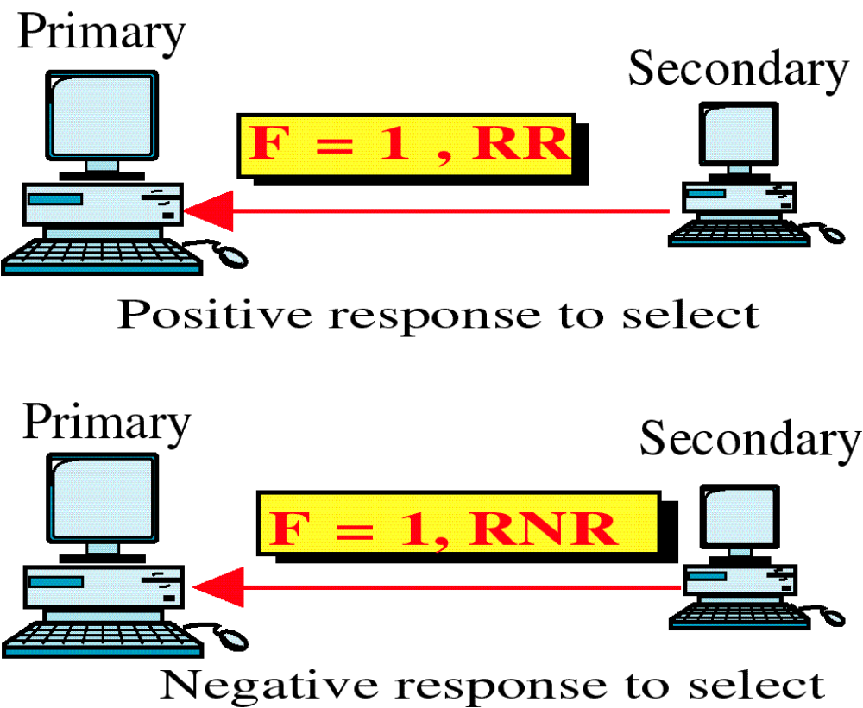
Use of P/F Field
WCB/McGraw-Hill
© The McGraw-Hill Companies, Inc., 1998

Slide 31
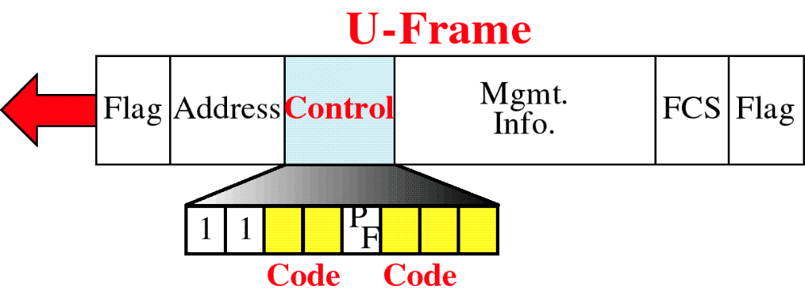
U-Frame Control Field
  Unnumbered frames are used to exchange session management and control information between connected devices.
  U-frame codes are divided into two sections: a 2-bit and 3-bit before and after the P/F bit, i.e 32 different types of U-frames.
WCB/McGraw-Hill
© The McGraw-Hill Companies, Inc., 1998

Slide 32
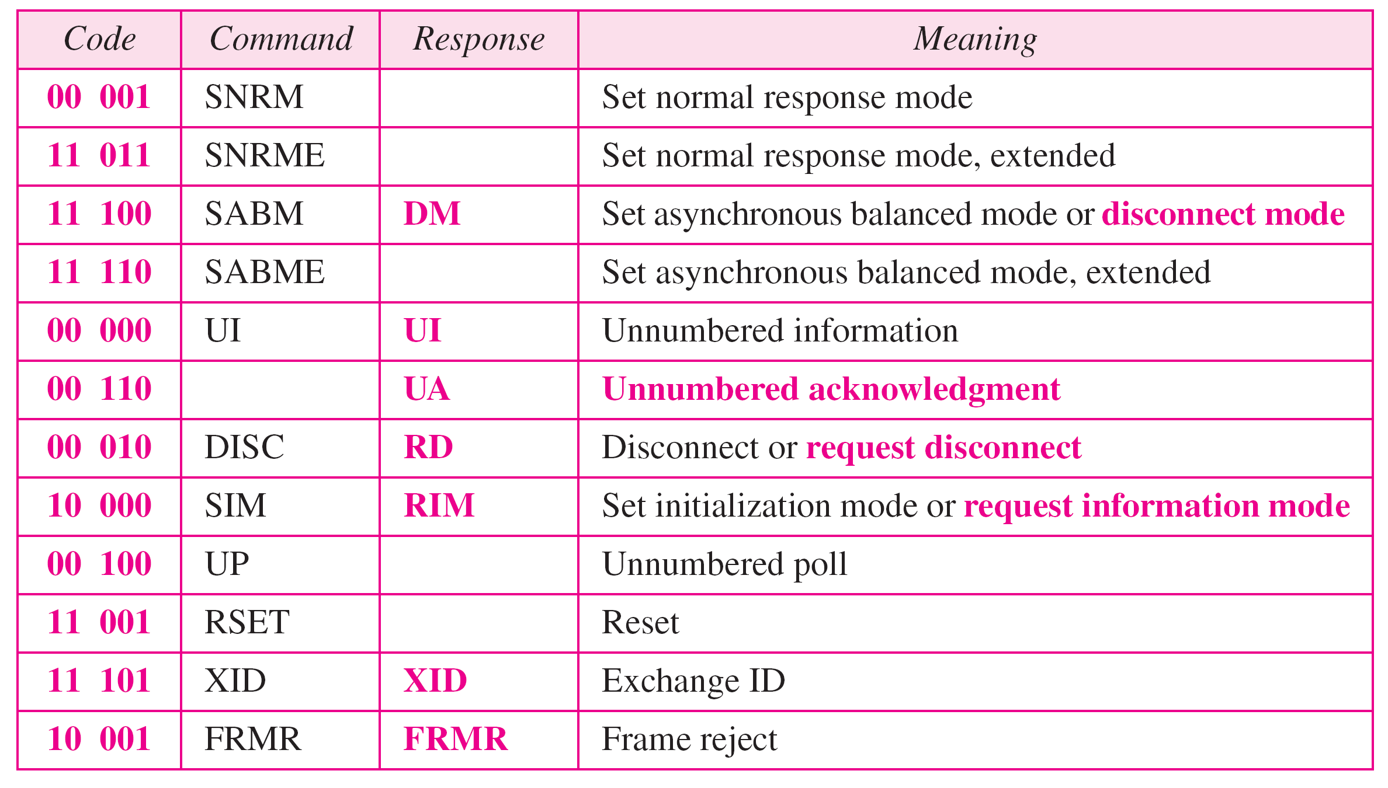
Table 11.1 U-frame control command and response
11.<number>

